Slide 1
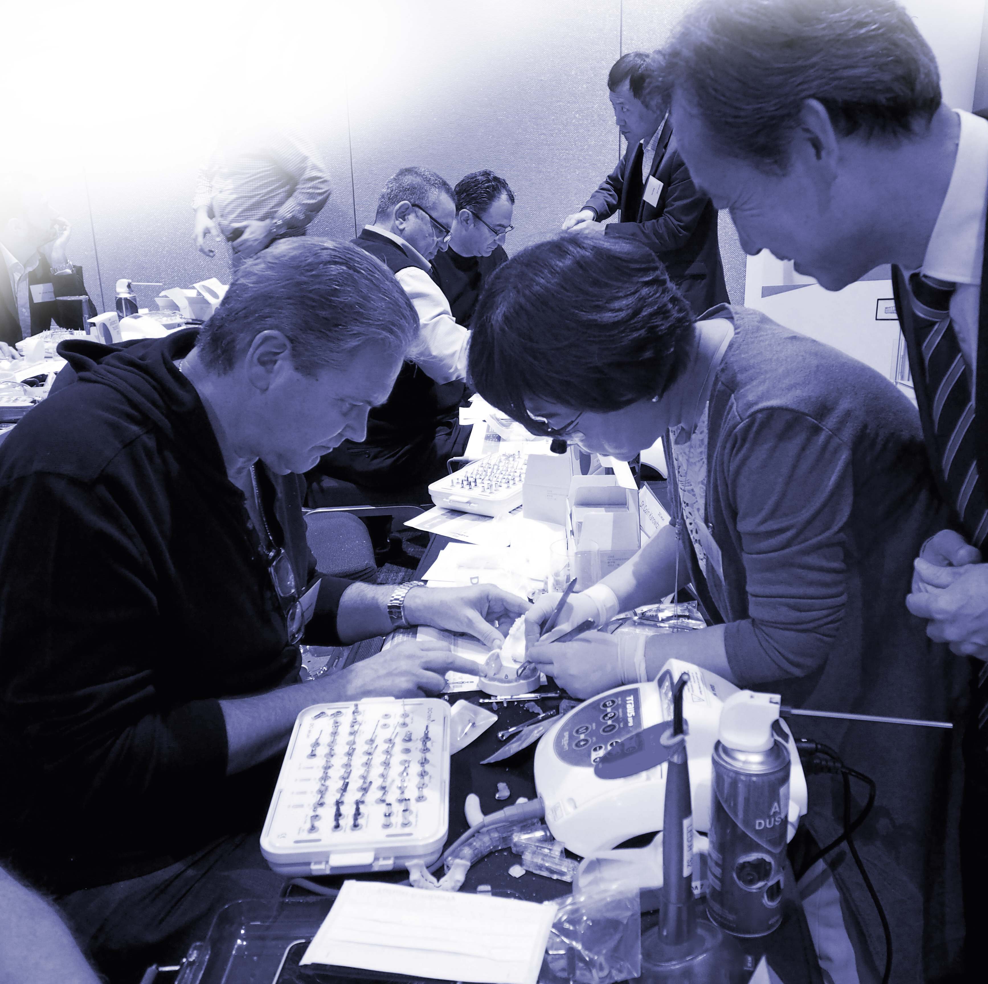
DIO DIGITAL ACADEMY
Practice
Case 05
Single Sinus Lift (#3)

Slide 2
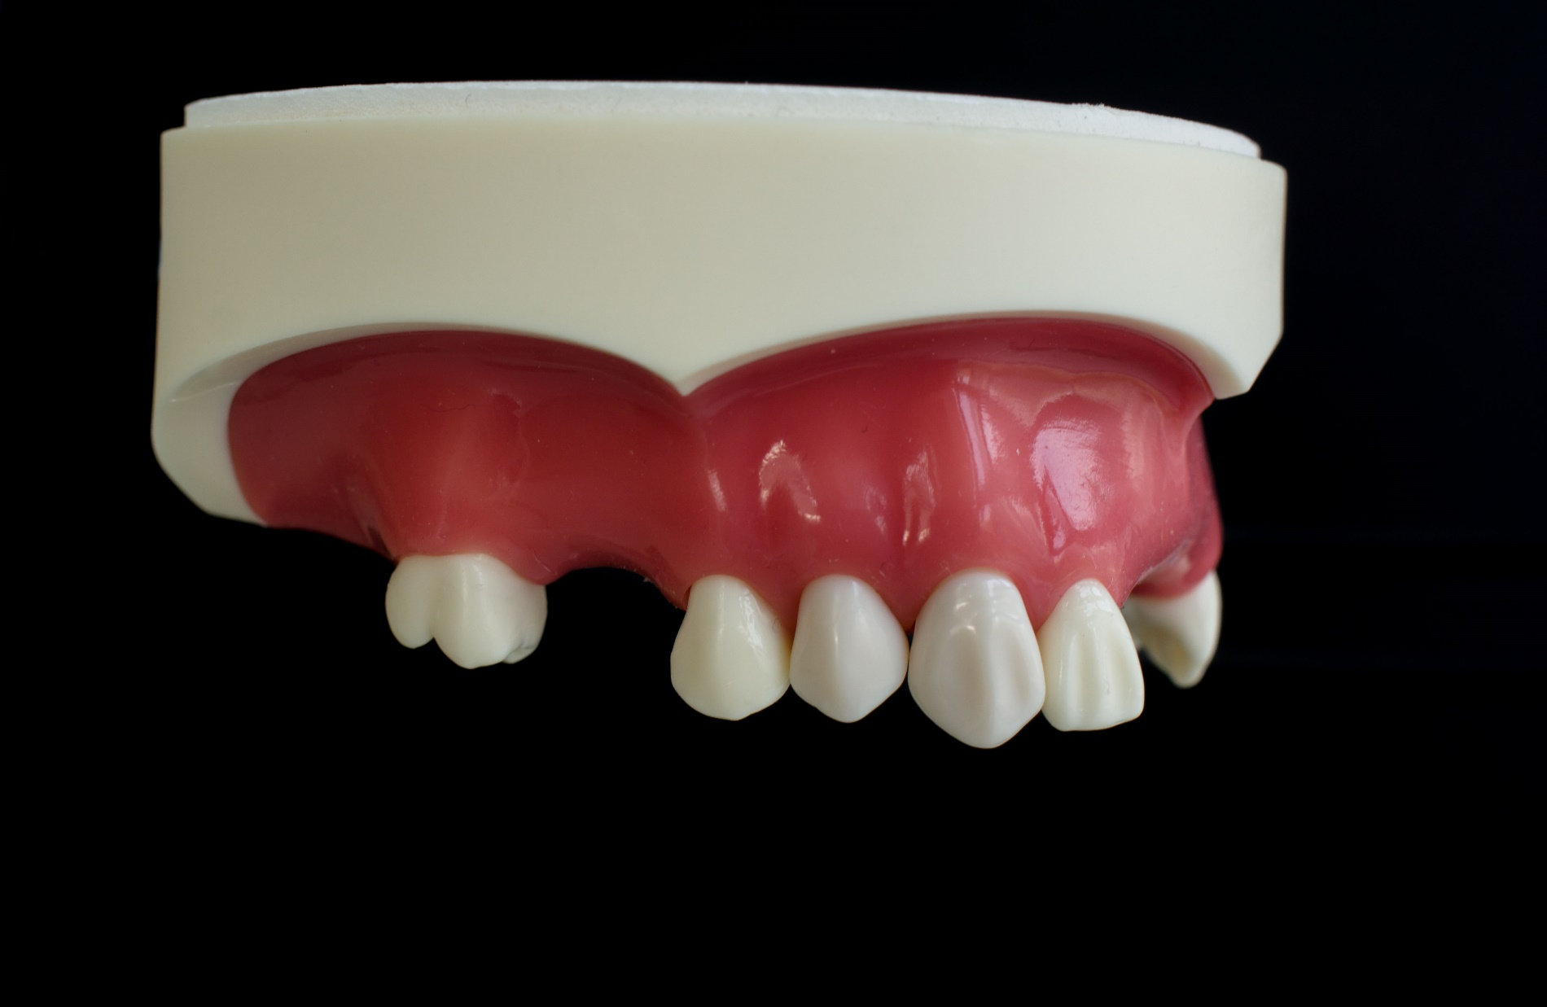

Case 5
• Fixture Ø5.0 x 10mm
• Healing abutment Ø5.5 x 4mm
#16
Sinus single case

Slide 3
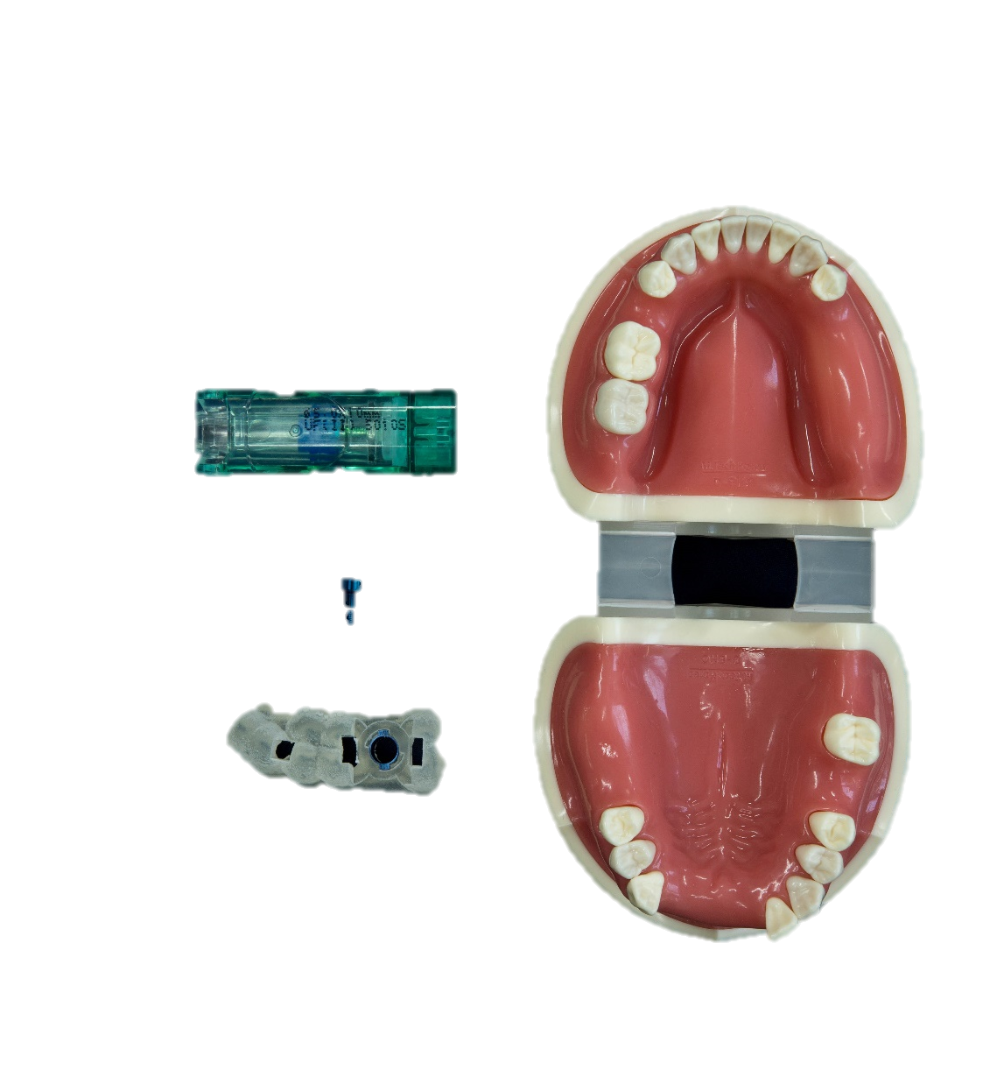
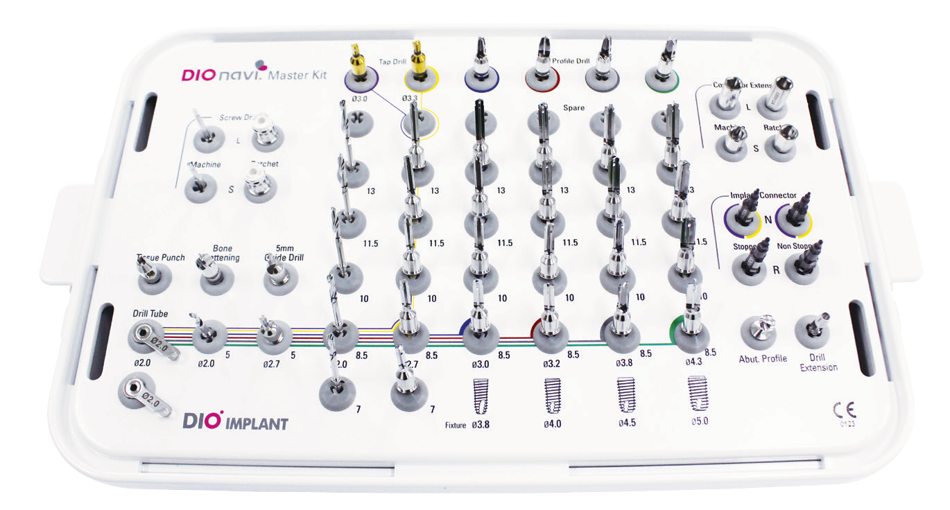
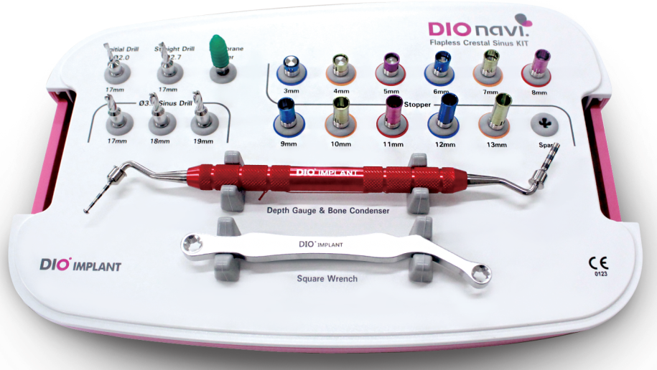
Hands-on Materials

Slide 4
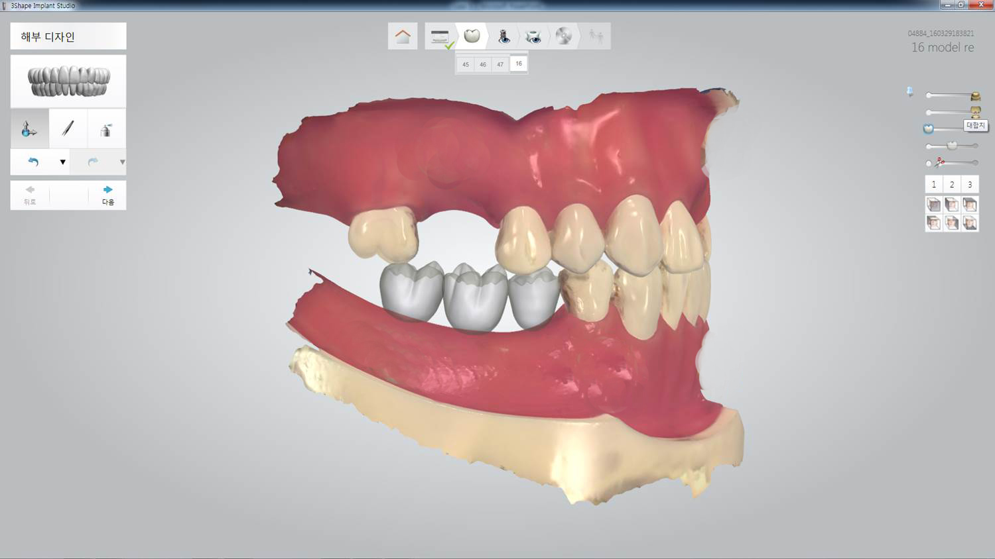
Anatomical Design
#16

Slide 5
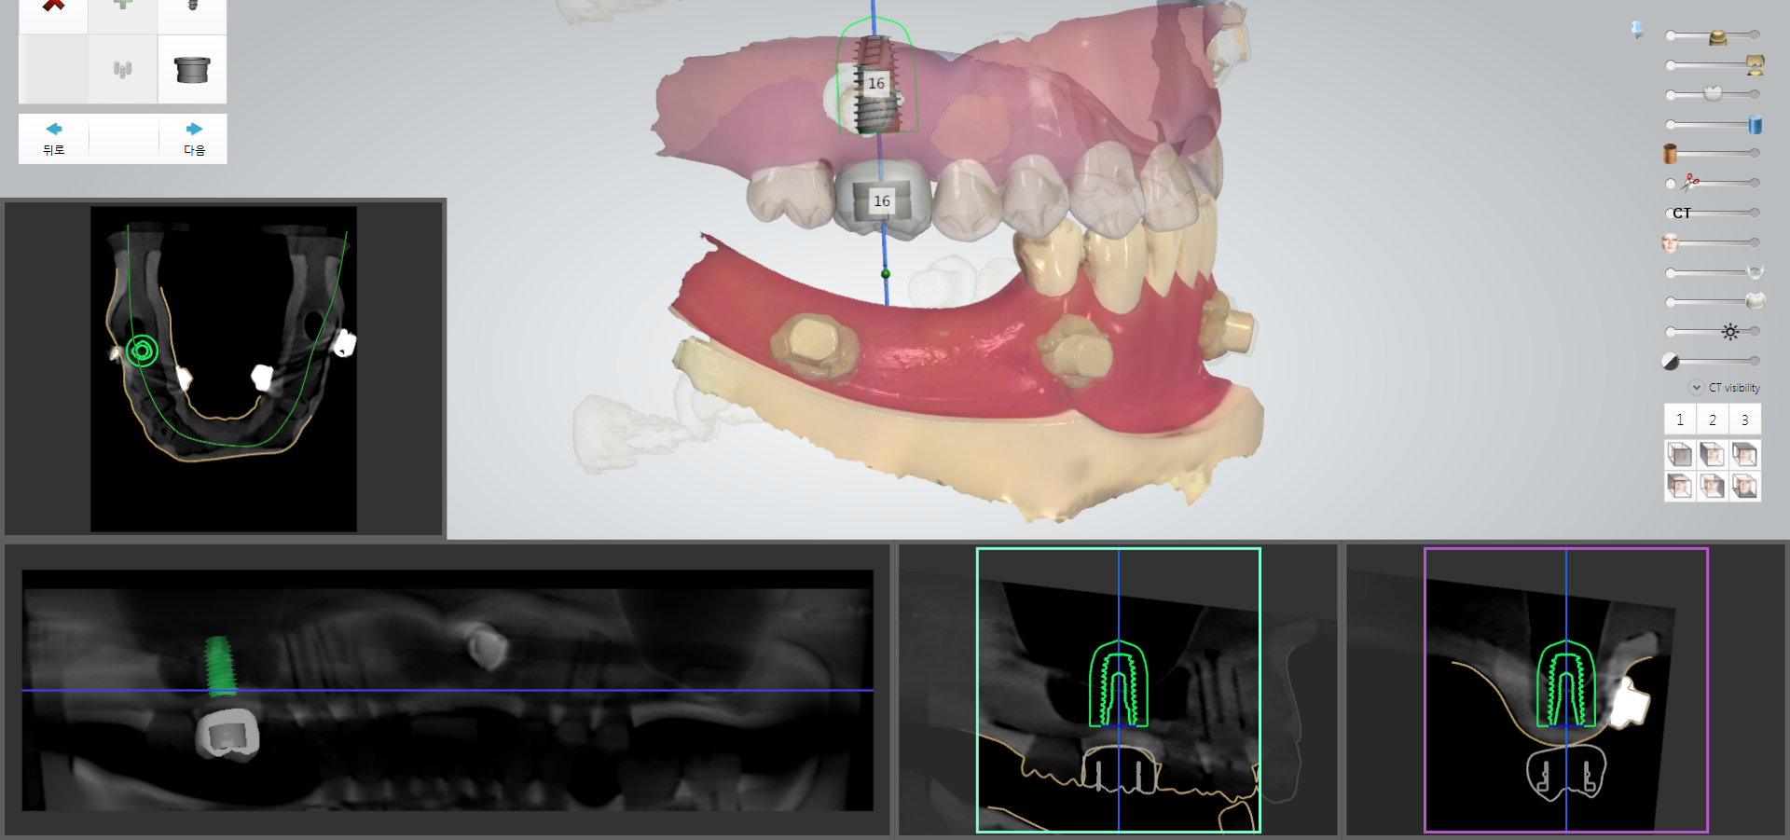
Implant planning

Slide 6
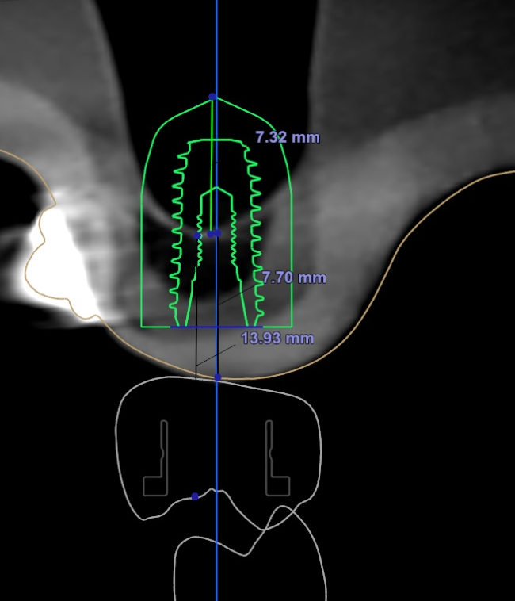
#16
Understanding of
Planning Figures
B
L

Slide 7

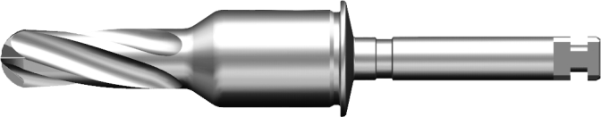

#16
Understanding of
Planning Figures
② Sinus Opening
B
L
Guide + Bone height
13.93
Offset
① Approaching Sinus Wall
Ø3.2 x 18

Slide 8

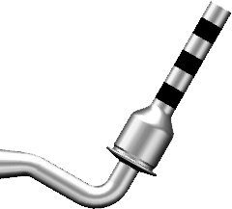

#16
Augmentation height
7.32
②Sinus Opening
④ Height of elevation
Mucosa + Residual bone height
B
L
7.70
Guide + Bone height
13.93
③ Required to set
Stopper for GBR
Offset
① Approach Sinus Wall
Ø3.2 x 18
Notes:
1. 접근
2. 오픈
3. 본 인젝션위해 스타퍼 길이 결정
4. 엘리베이션 높이

Slide 9
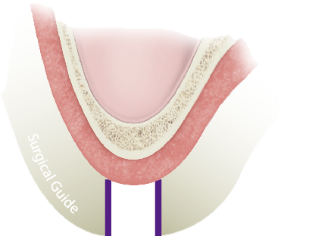
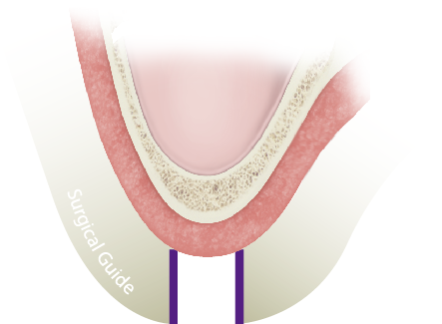




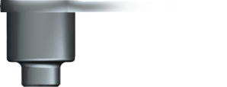
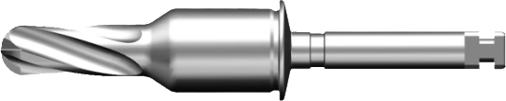


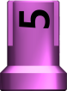
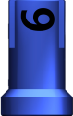

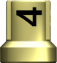
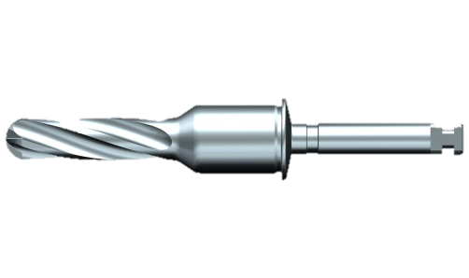
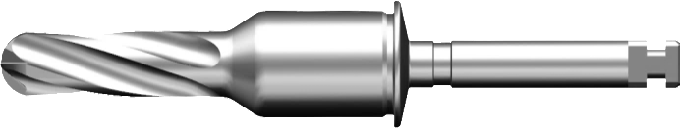
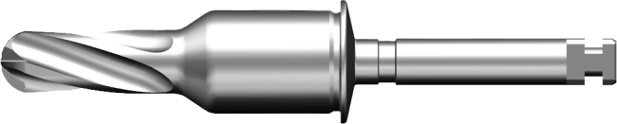
#16
DIOnavi. Crestal Sinus KIT
1~2mm
Ø3.2 × 21
Ø3.2 x 17
Ø2.0mm Stopper
Ø2.0 Initial Drill
Ø3.2 x 17
Ø3.2 x 18
Ø3.2 x 19
Round Drill(Sinus Drill)
* Option: 21mm
Notes:
이니셜드릴로 사이너스까지 접근 (관통 금지)
라운드드릴 + 스타퍼를 이용하여 바텀라인을 관통한다.
4종류 라운드드릴이 있다. (21 옵션)

Slide 10
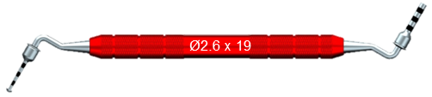
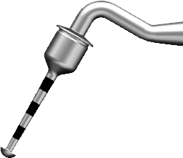







#16
Depth Gauge & Bone Condenser
Ø2.6
Ø2.6
1
2
4
9
6
8
19
10
12

Slide 11
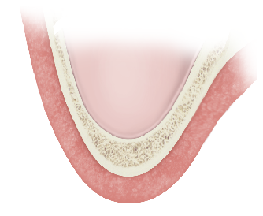
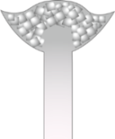
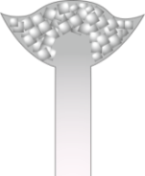
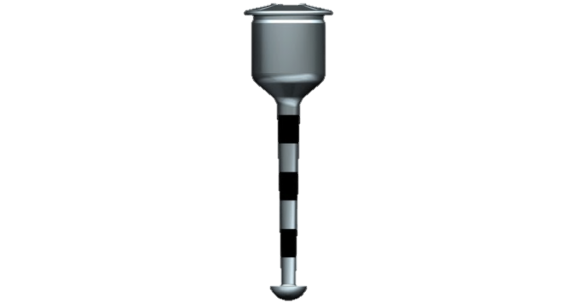
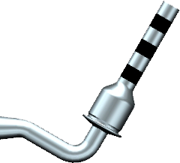

#16
Depth Gauge & Bone Condenser
Bone Condenser
Depth Gauge
H (7.7mm)
Selection guidelines of stopper
Bone + Gum = H(mm) | 2 | 3 | 4 | 5 | 6 | 7 | 8 | 9 | 10 | 11 | 12 | 13 | 14
Bone Condenser Stopper | 16 | 15 | 14 | 13 | 12 | 11 | 10 | 9 | 8 | 7 | 6 | 5 | 4
Depth gauge Stopper | 15 | 14 | 13 | 12 | 11 | 10 | 9 | 8 | 7 | 6 | 5 | 4 | 3

Slide 12
Drilling Protocol

Slide 13

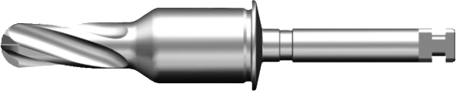


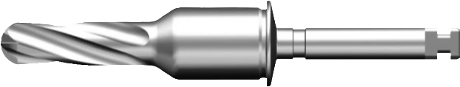
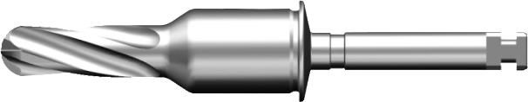



Offset + Residual bone height
The anatomical depth measured by CT scan is 14mm but it has been adjusted to 15mm considering manufacturing tolerance of the hands-on model
H(mm)
15mm
(14.5mm~15.4mm)
Residual bone height
8
7
6
5
4
3
2
Ø3.2 x 17
Ø3.2 x 19
Ø3.2 x 18
Ø3.2 x 17
Ø3.2 x 17
Ø3.2 x 17
Ø3.2 x 17
9 mm
17
16
15
14
13
12
11

Slide 14
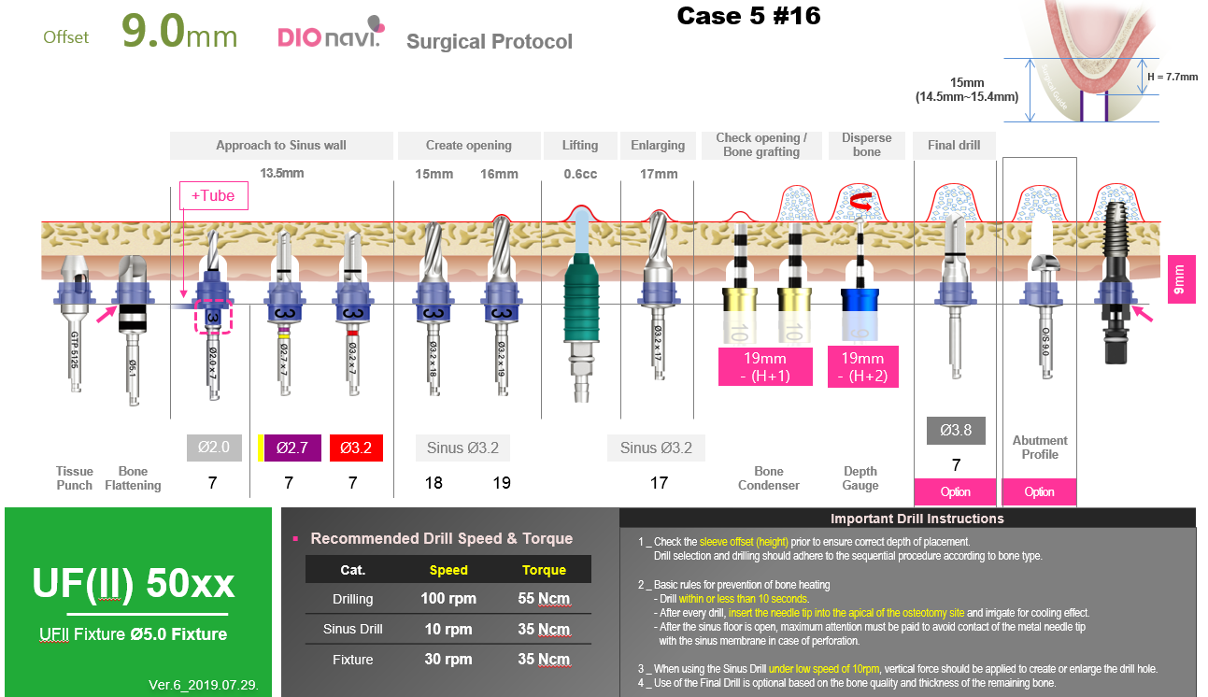
#16

Slide 15
Please enjoy
your practice time!

